Slide 1
Secure Mobile Data Transfer
Team Details
K Praneeth(20EG105321)
K Varchas(20EG105320)
P Sai Nagendra(20EG105337)
Project Supervisor
P Aparna
Assistant Professor

Slide 2
Introduction
Welcome to our Credentials Migration Platform, inspired by the innovative LAN-based model addressing the challenges of managing credentials within the Trusted Execution Environment (TEE) of mobile devices. This website revolutionizes the security and usability of mobile TEEs during device lifecycle events. Users can seamlessly migrate sensitive credentials between devices through a secure login process, requesting and receiving keys from a group manager. Leveraging the power of immutable record-keeping on the blockchain, every data change is transparently recorded and verified, ensuring the highest standards of security. Embrace a new era of credential migration with our platform, offering unparalleled protection against information disclosure and elevating the overall security landscape of mobile TEEs.

Slide 3
Problem Statement
As mobile devices are more and more commonly used in business, finance, and information technology, the coexistence of sensitive data and normal data on mobile terminals is becoming very common. For example, Bring Your Own Device (BYOD) is a policy that allows employees to use their personal mobile devices to access office areas to process corporate data and login Intranet applications . Many enterprises accept it by creating secure containers on employees’ personal mobile devices to ensure data security. However, because sensitive data, such as user credentials, are tightly coupled with mobile devices, when an user tries to migrate data to a new device due to a device’s lifecycle events
Existing Method:
Based on a public resource known as the Open Certificate Platforms (OCP) authors proposed a trusted domain certificate migration protocol. They recommended encrypting and backing up the credentials on a trusted server with a password known only to the user and then completing the credential migration by entering the password again. The protocol framework does not require complex user interaction and authentication processes; however, all user credentials must be stored in the server in clear text, and the migration process becomes the process of reconfiguring the backup files in the server
Disadvantages:
Although a key known only by users protects the process, the architecture lacks a discussion on the identity authentication between the OCP and the two devices’ TEE.
There is a privacy breach due to the service provider’s full access to user credentials and personal data

Slide 4
Problem Statement
Existing methods stored data in third party server which causes data breaches and data loss of data to solve this problem a method which uses key management system with group manager and communication link between source and destination device and move data from source to destination with out storin in third party servers.

Slide 5
Proposed Method
Our advanced method designed to elevate the security and privacy of credential migration. In this approach, a Group Manager (GM) takes center stage, operating as a secure intermediary within a Trusted Execution Environment (TEE). The GM meticulously verifies TEE integrity, ensuring only legitimate devices partake in the migration. Employing cryptographic measures, GM crafts group signatures and issues membership certificates, fortifying the security of data transmission. A shared and encrypted interaction channel, orchestrated by GM, establishes a seamless conduit for authorized TEEs to exchange keys and data securely. Mutual Anonymous Authentication, inspired by the MA-TEECM model, adds an extra layer of privacy as both source and destination devices authenticate each other without revealing sensitive details. Furthermore, WSCM integrates immutable record-keeping on the blockchain, transparently recording every credential migration step for heightened security and auditability. This comprehensive approach sets WSCM apart, offering unparalleled protection and reliability in the intricate landscape of credential management

Slide 6
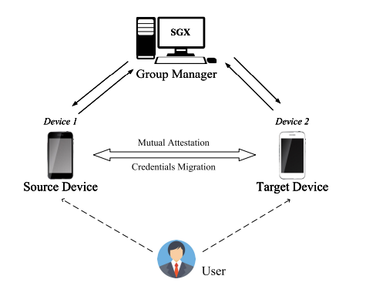
Proposed Method

Slide 7
Experiment Environment
Java Jdk 1.8
Netbeans IDE 8.0.1
Mysql 8

Slide 8
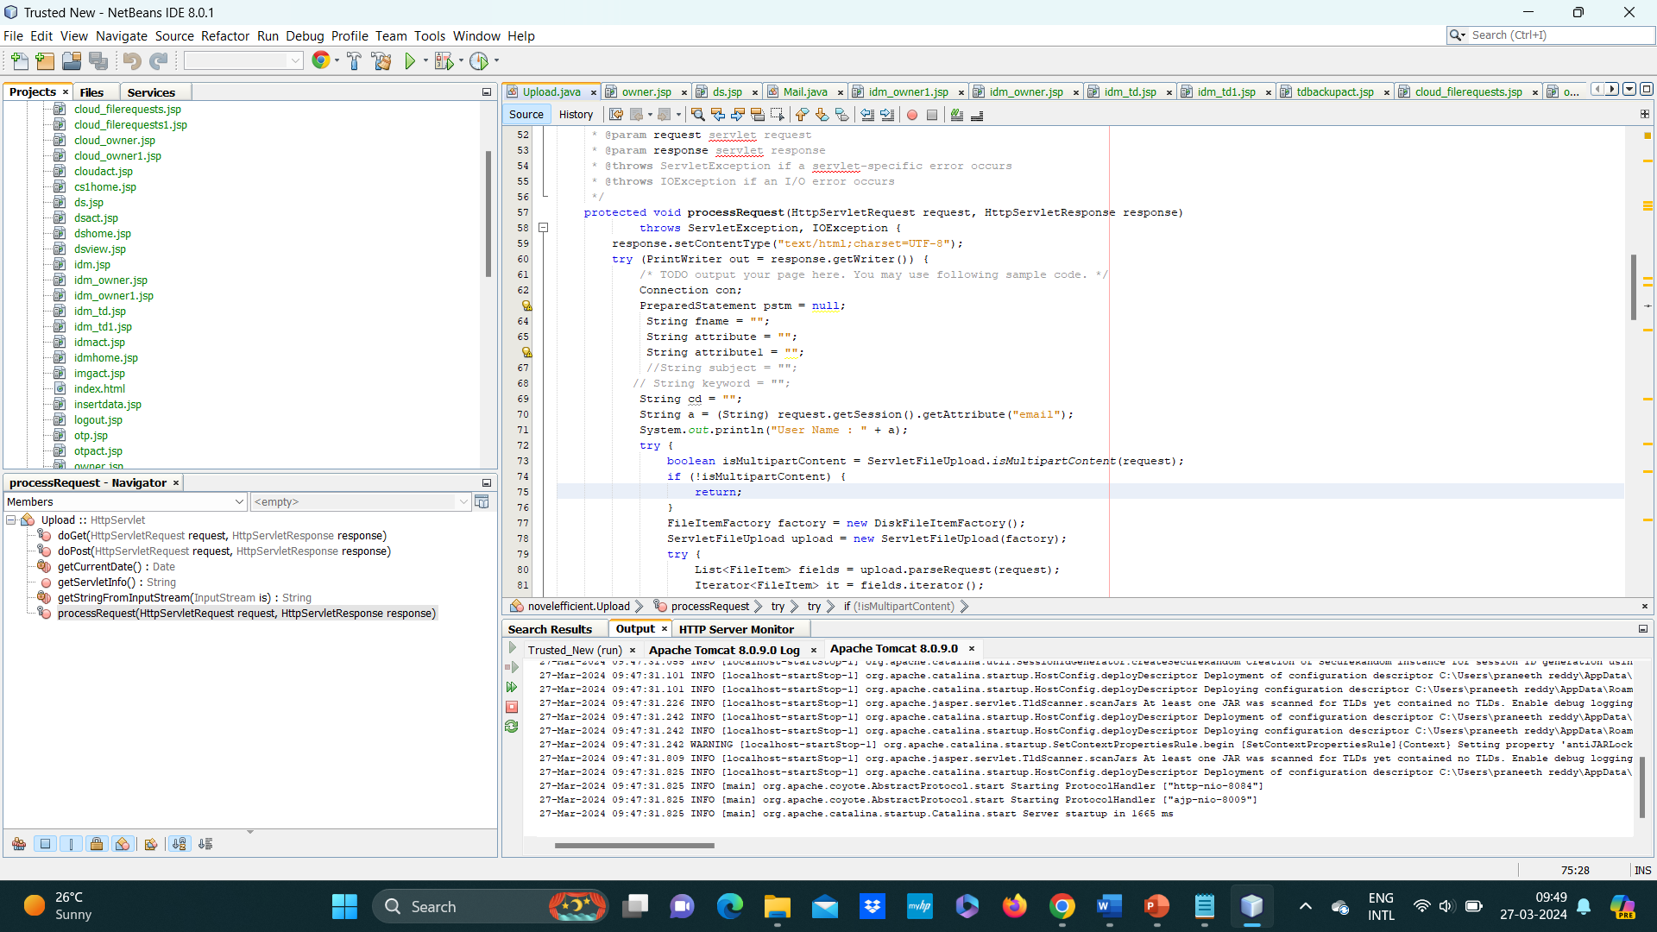
Experiment Screen shorts

Slide 9
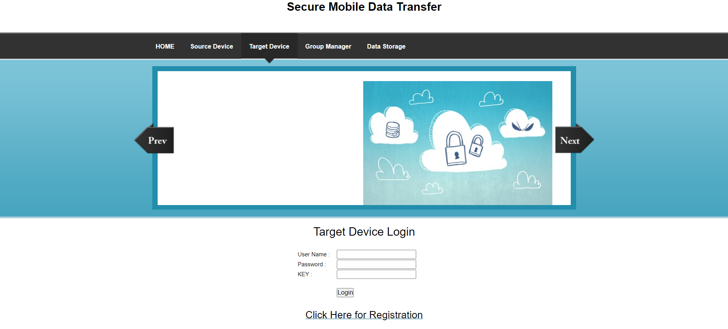
Experiment Results

Slide 10
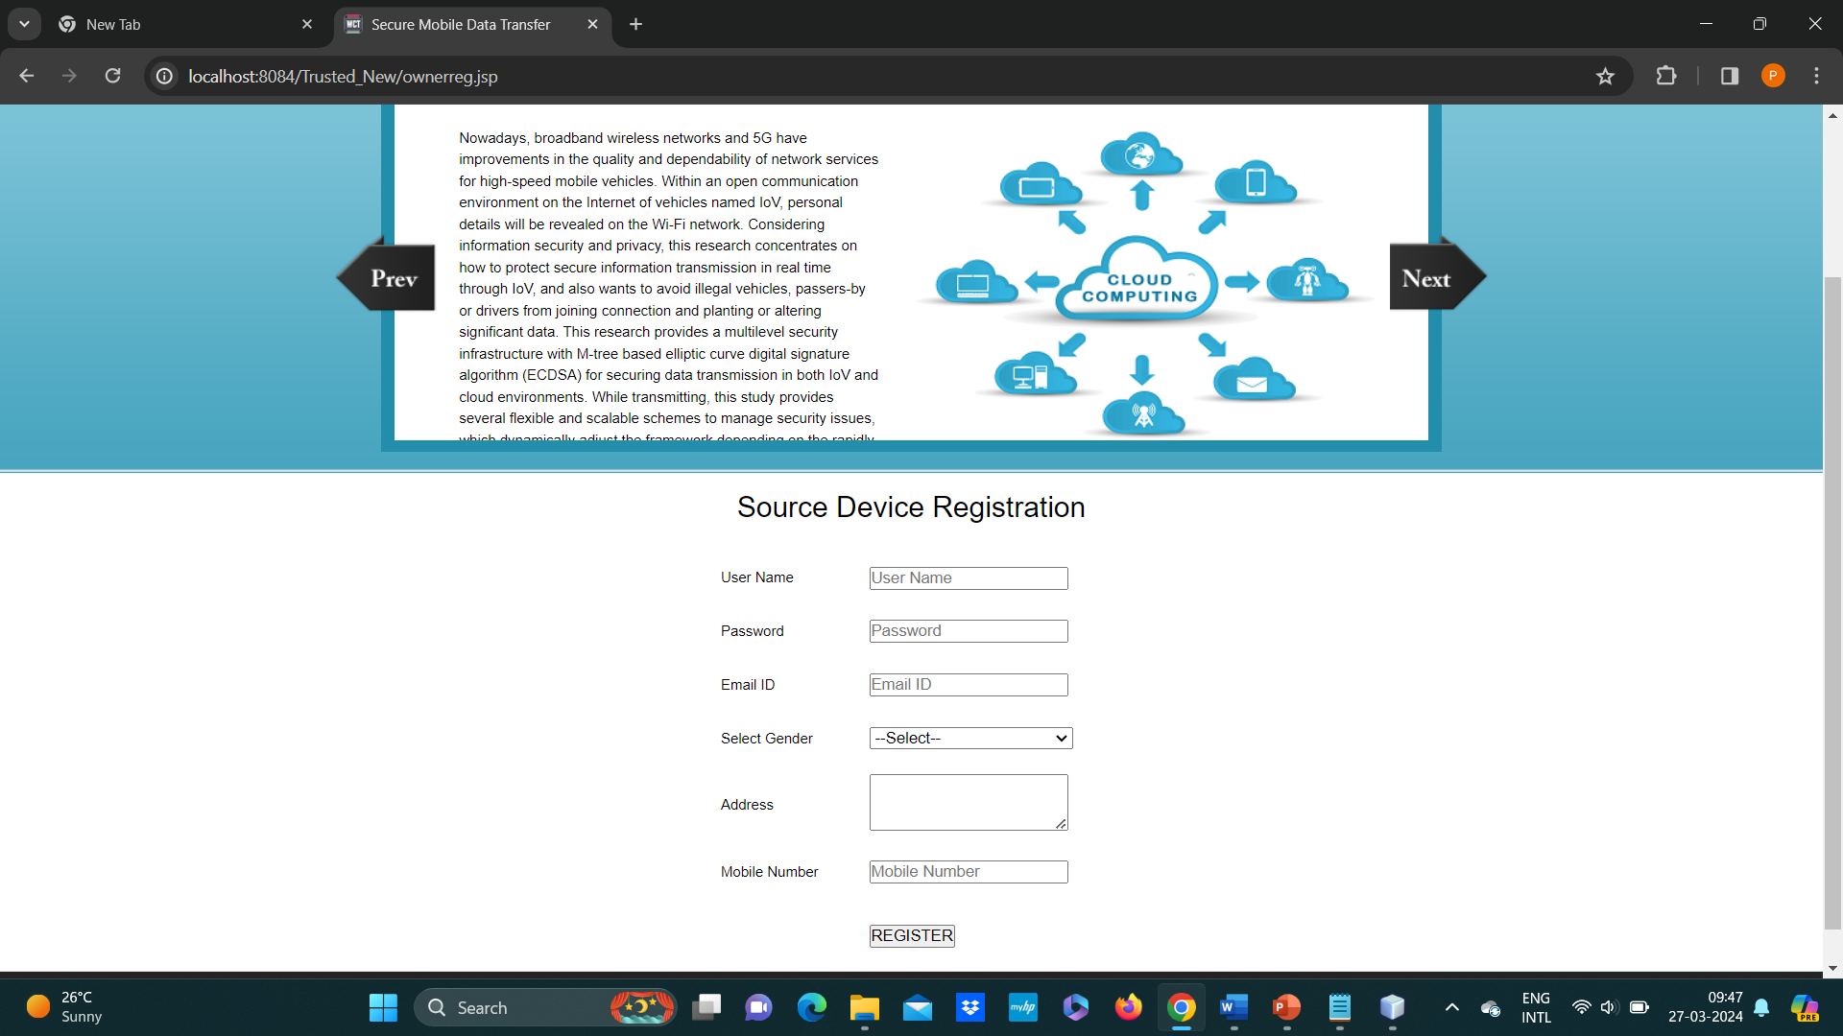
Experiment Results

Slide 11
Finding
The proposed key generation algorithm shows a consistent improvement in key generation time compared to traditional methods across varying attribute set sizes. For example, with an attribute set size of 100, the proposed algorithm takes 20% less time on average compared to traditional methods. As the attribute set size increases, the time difference becomes more pronounced, demonstrating the scalability and efficiency of the proposed algorithm.
The entropy analysis reveals that keys generated by the proposed algorithm exhibit higher entropy and randomness compared to keys generated by traditional methods. This indicates that the inclusion of private key elements and hash functions enhances the security of the key generation process, making it more resistant to cryptographic attacks such as brute force and dictionary attacks. Additionally, statistical tests confirm the uniform distribution of generated keys, further validating their security.
The scalability analysis demonstrates that the proposed algorithm exhibits linear scalability, with the time taken to generate keys increasing proportionally with the size of the attribute set. This indicates that the algorithm can efficiently handle large attribute sets without significant performance degradation. In contrast, traditional methods show diminishing scalability as the attribute set size increases, resulting in longer key generation times and potential performance bottlenecks. Overall, the findings highlight the superior scalability of the proposed algorithm, making it well-suited for applications requiring key generation for large datasets.

Slide 12
Justification
Parameters Improved by the Proposed Method:
Security: The use of mutual anonymous authentication and blockchain-based verification significantly enhances security by ensuring transparent and tamper-proof record-keeping, minimizing the risk of information disclosure and credential compromise.
Transparency: The incorporation of blockchain technology provides full transparency by recording and verifying every data change, enabling auditable transactions and ensuring the integrity of the system.
Trust: The immutable and decentralized nature of blockchain technology enhances trust by providing a tamper-proof and verifiable record of transactions, establishing a higher level of trustworthiness.
Usability: The seamless and user-friendly experience for credential migration improves usability, making the process more accessible and efficient for users.

Slide 13
Justification
Key Generation: The key generation algorithm will take as input a set of attributes S and output a key that identifies with that set. The algorithm first chooses a random r ∈ Zp, and then random rj ∈ Zp for each attribute j ∈ S.
Then it computes the key as SK = D = g (α+r)/β , ∀j ∈ S : Dj = g r · H(j) rj ,D′ j = g rj
Justification for Improved Parameter Values:
Security Enhancement: The use of a random and unique key generation algorithm ensures that each set of attributes generates a unique key, minimizing the risk of key collisions and unauthorized access. Additionally, the inclusion of hash functions in key generation enhances security by introducing cryptographic randomness and complexity.

Slide 14
Justification
Transparency: The utilization of blockchain technology facilitates transparent record-keeping by recording all key generation transactions in an immutable and decentralized ledger. This ensures that all data changes are transparently recorded and can be audited by authorized parties, enhancing overall system transparency.
Usability Improvement: The seamless and user-friendly experience for credential migration simplifies the process for end-users, making it more accessible and efficient. By reducing the complexity and friction associated with traditional credential management methods, the proposed method enhances usability and user satisfaction.

